Slide 1
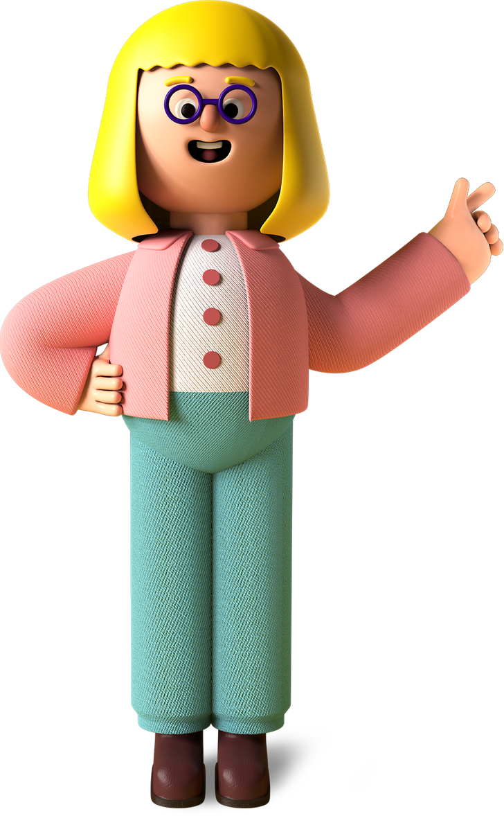


Shanika’s
Project

Slide 2

Project Name
My PortFolio

Slide 3
Project Link
https://studentpla.github.io/my-portfolio/

Slide 4

My favourite part about the project
My First Own website
It shows all my projects in one page.
My achievements

Slide 5

What I learned from it
01
How to create my own portfolio.
02
Working on Visual Studio and Github
03
Working on HTML and CSS
04
Different tags of html

Slide 6

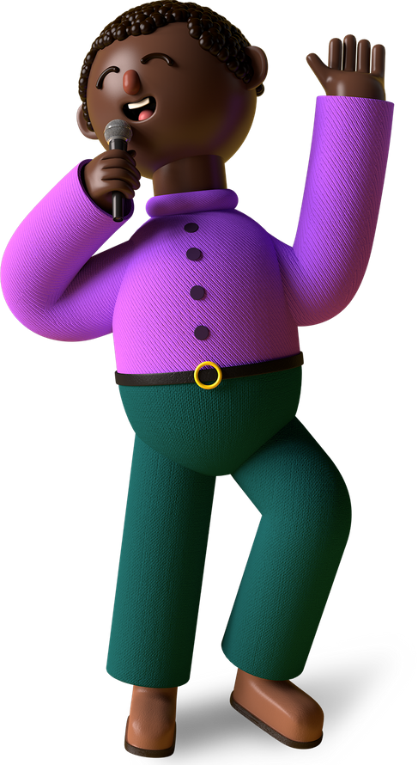
Thank You!
Merry X’Mas & A Happy New Year
From Shanika
A Young Coder In The Making!

